Slide 1
Leveraging the Power of a Desktop Remotely
Dylan Lathrum

Slide 2
The Problem
Power and Portability
Desktop computers vs laptops
Power of a desktop
Convenience of a laptop
Compromise of a gaming laptop
Shift towards mobility
COVID-19

Slide 3
Limitations
Global chip shortage
Rising prices
Limited availability
Supply line disruptions

Slide 4
State of the Art

Slide 5
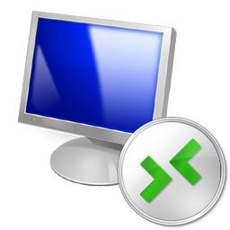


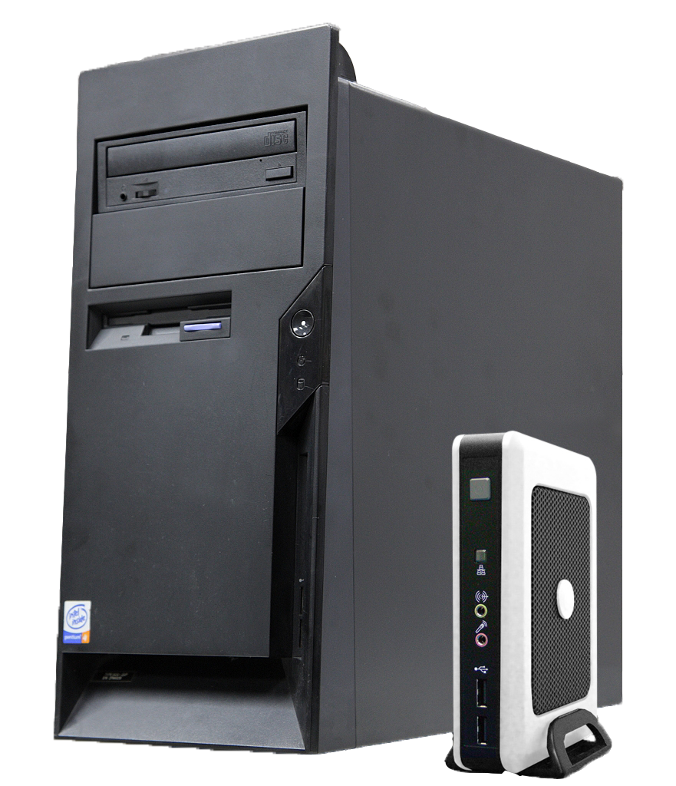
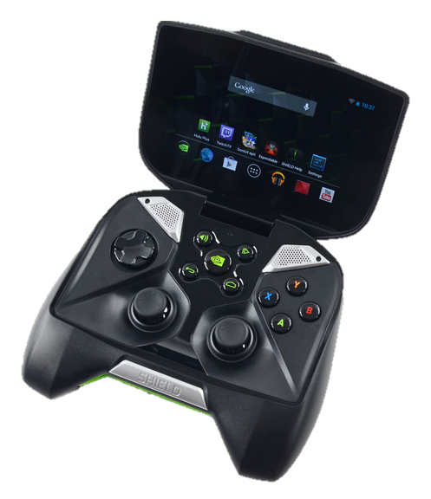
State of the Art
Built-in Windows solution
Clients on most platforms
Usability drawbacks
Microsoft’s Remote Desktop Protocol
(RDP)

Slide 6
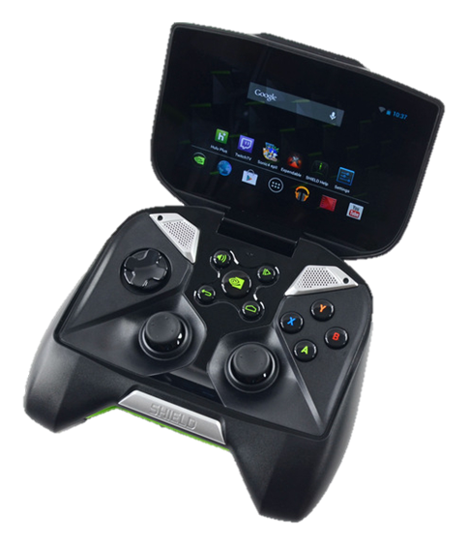
State of the Art
Windows, Mac, Linux hosts
Chromium browser is the client
Limited by the browser
Chrome Remote Desktop
(CRD)

Slide 7
State of the Art
Platform independent
Built to be as simple and lightweight as possible
Security and performance concerns
Virtual Network Computing
(VNC)

Slide 8
State of the Art
Corporate hardware solution
Headless – not actually portable
Thin Clients

Slide 9
State of the Art
Hardware to connect to Nvidia GPU
Sold very poorly
Closed Source Protocol
…Until Moonlight
Nvidia Shield
(GameStream)

Slide 10
Requirements
Hardware
Is it feasible to construct a device capable of steaming a host’s screen at a lower or comparable cost to existing solutions?
Protocol
Does a protocol exist that is efficient enough to stream demanding applications to the client?
Software
Can a software solution be built to utilize this protocol in a
manner that performant enough?

Slide 11
Developing the Hardware
Building a custom PCB

Slide 12
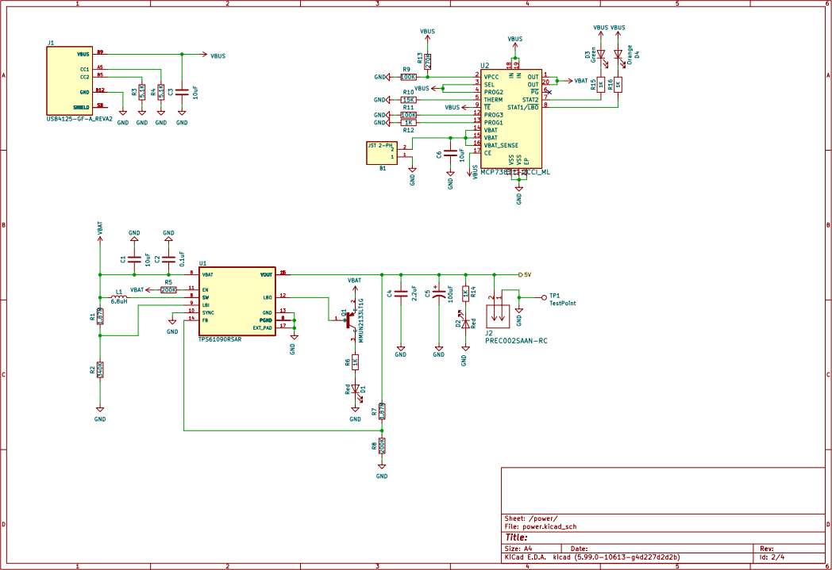
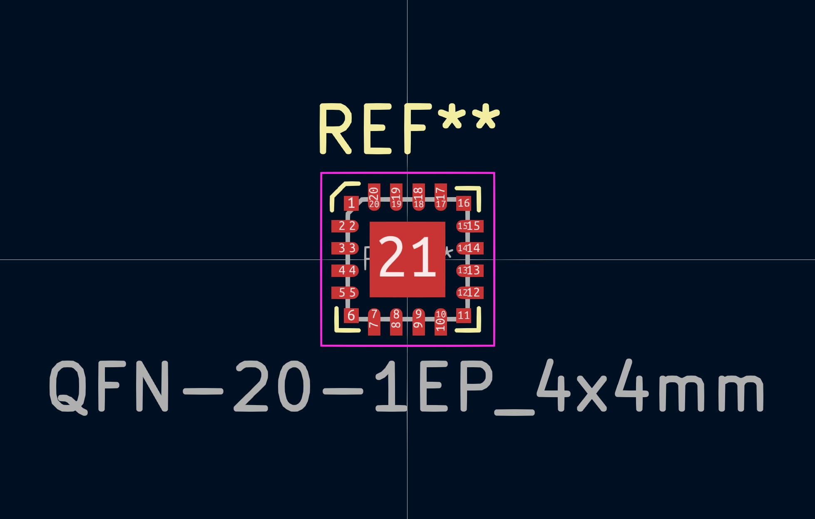
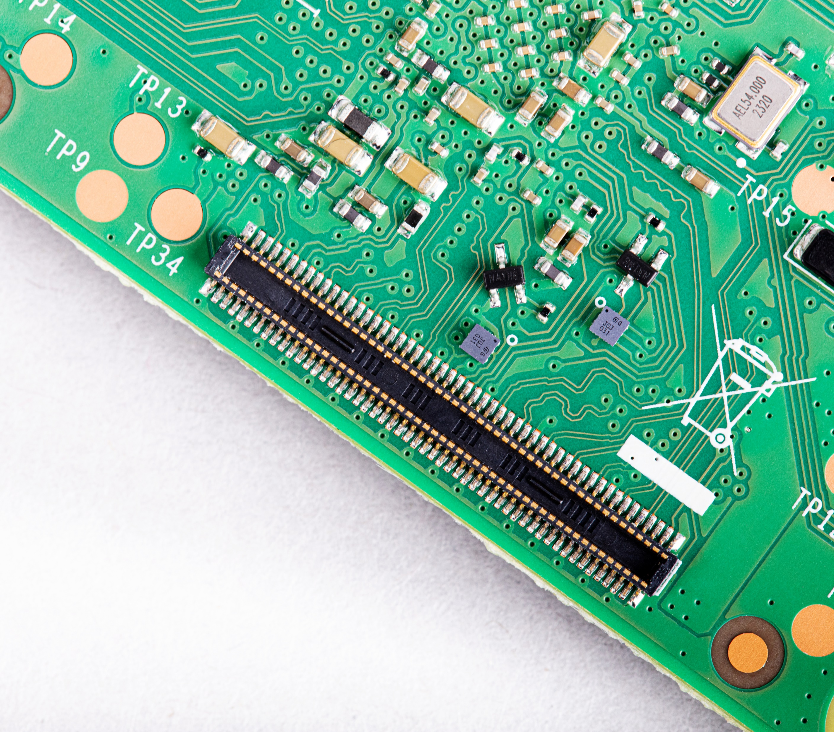
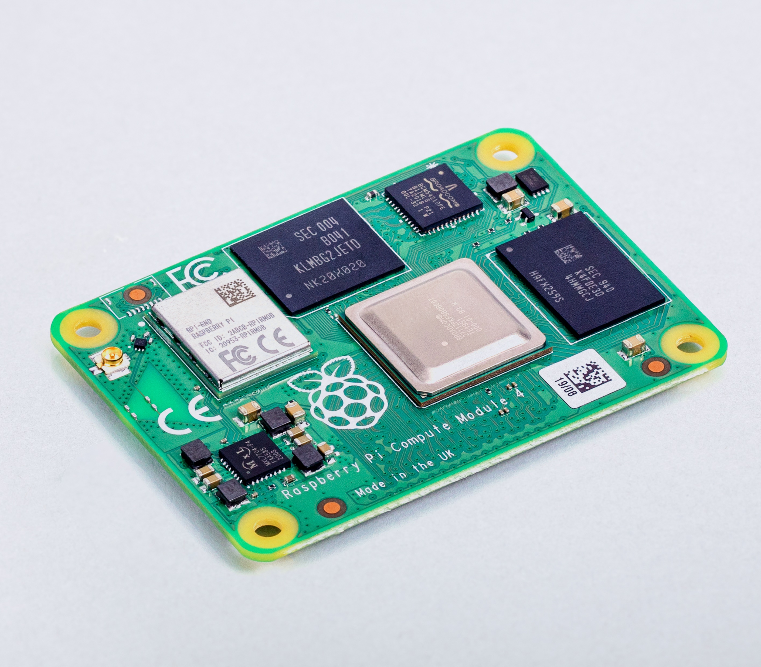
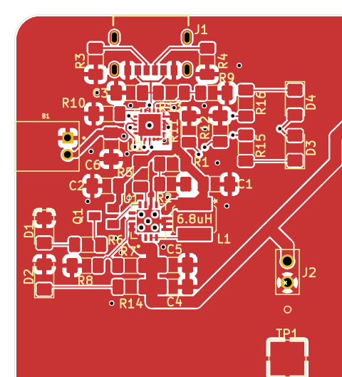
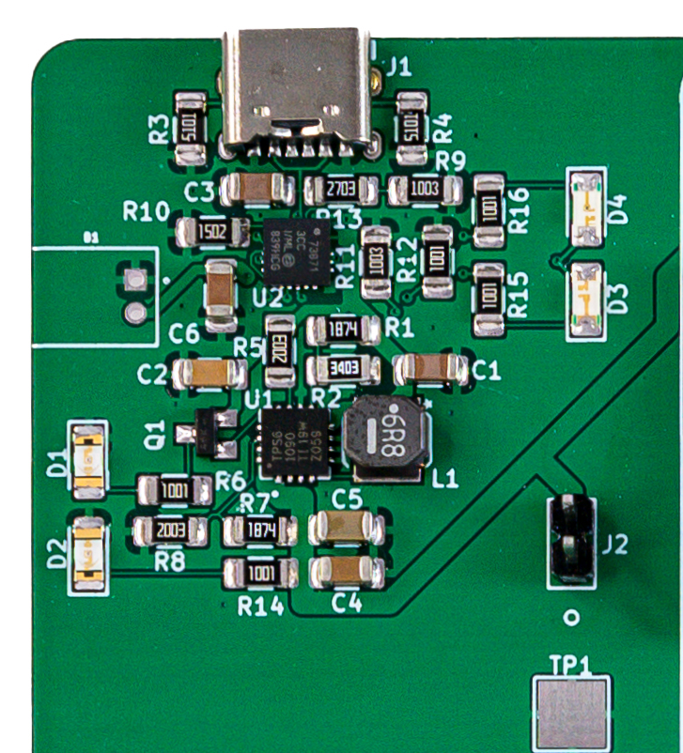
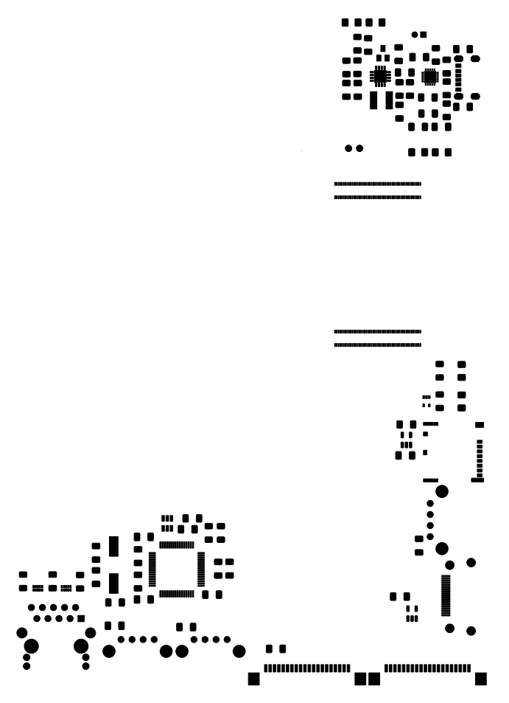

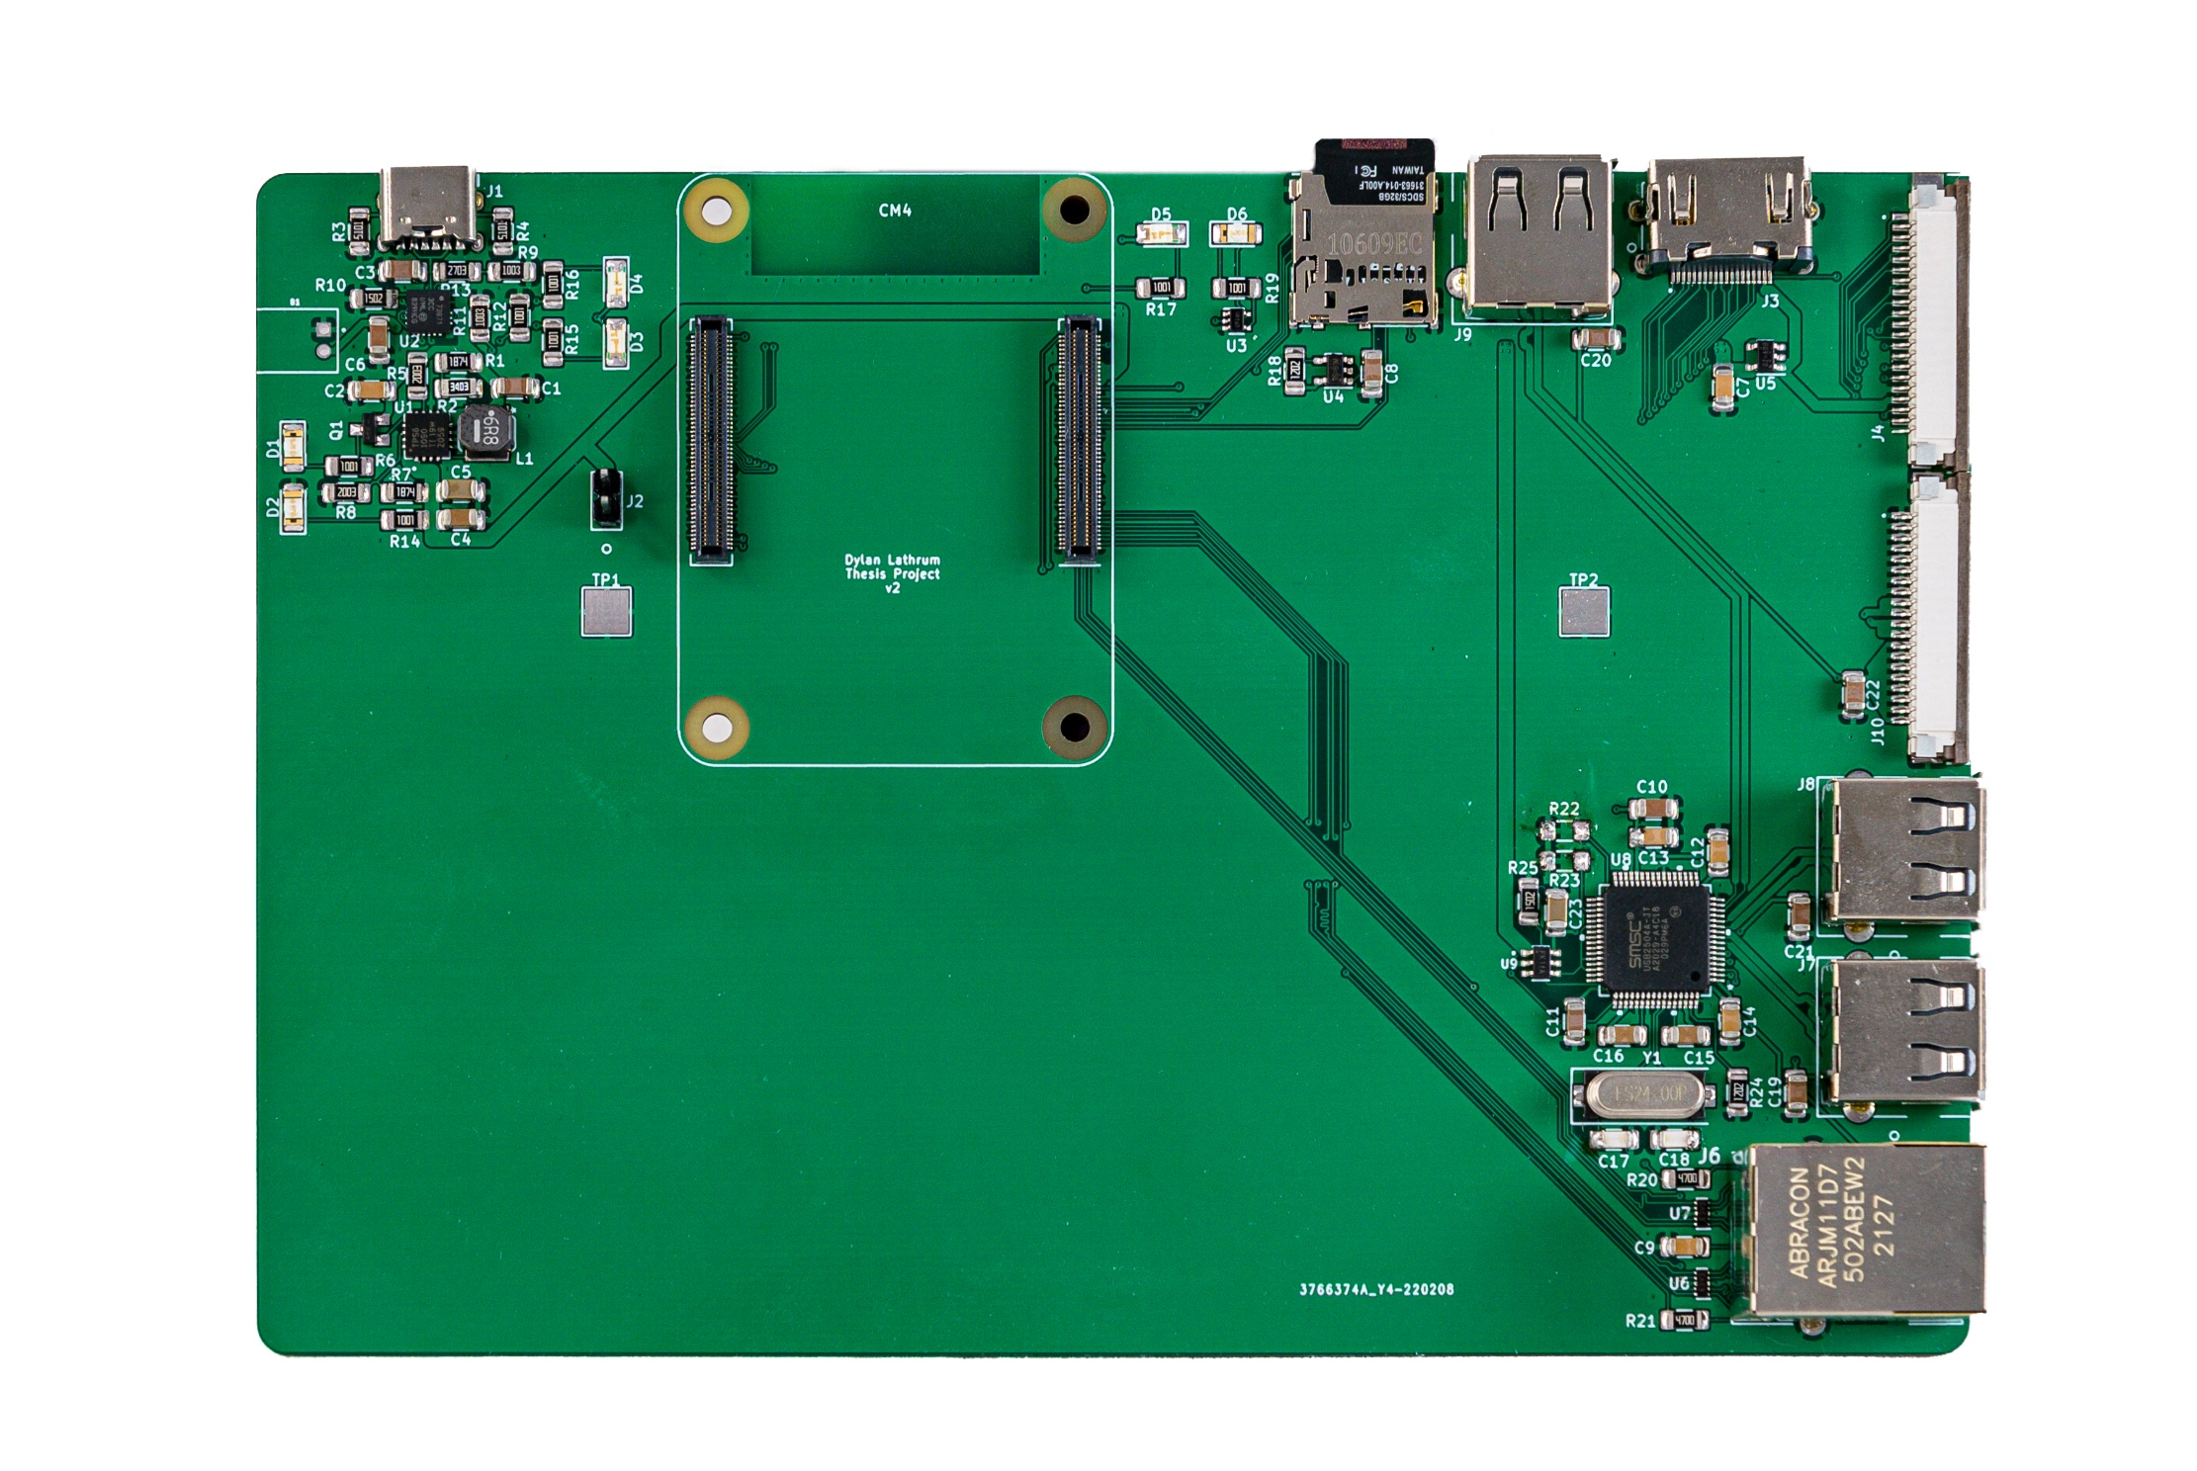
Developing the Hardware
Components
Design
Manufacture
Avoid reinventing the wheel
RPi Compute Module 4
Hardware features
USB, HDMI, Ethernet,
Internal Battery, Charging
Picking Parts
Split into sections
Power, USB, HDMI, CM4,
SD reader, Ethernet
Each section can fail individually
Working with sensitive components
Differential pairs
QFN-20-1EP_4x4mm
Using a stencil
Multiple iterations
Bypasses come in handy
QFN-20-1EP_4x4mm_RevA

Slide 13
Developing the Software
Making the project work

Slide 14
Developing the Software
Planning
ARM
Development
Nvidia GameStream
Closed source
Highly performant
Moonlight
Unofficial Open Source client
Core library extended for
different platforms
Fork new Moonlight client
ARM vs x86 architecture
Cross-compilation
Compilation toolchain
Compile project
Package project
Build image
Moonlight development
Track performance
FPS
Encoding/rendering time
Develop measurement tools
Input latency
Quality testing

Slide 15
Ideal, CPU stress, GPU stressed conditions
Testing Forked Moonlight, CRD, RDP, VNC
Procedure:
Reboot both machines for clean environment
Stress host if necessary using Blender
Open data collection tools
Connect client to host computer (sync clocks)
Type onto client’s keyboard
Responsivity and Latency
Testing Methodology

Slide 16
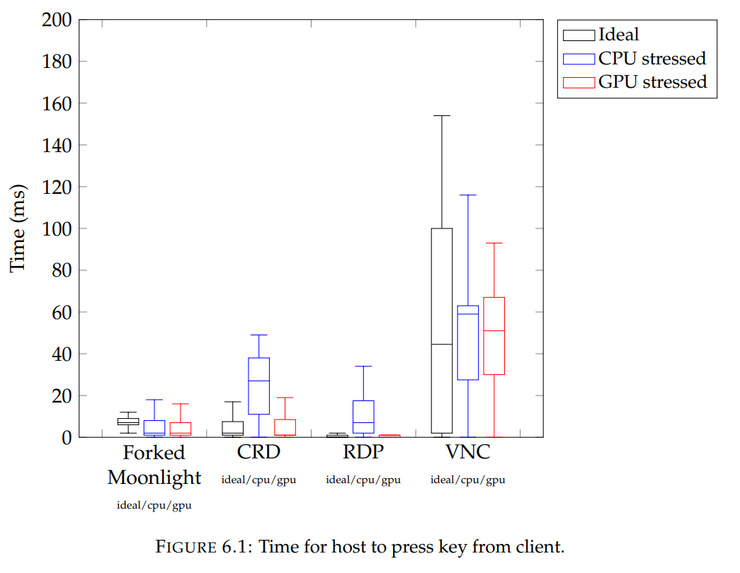
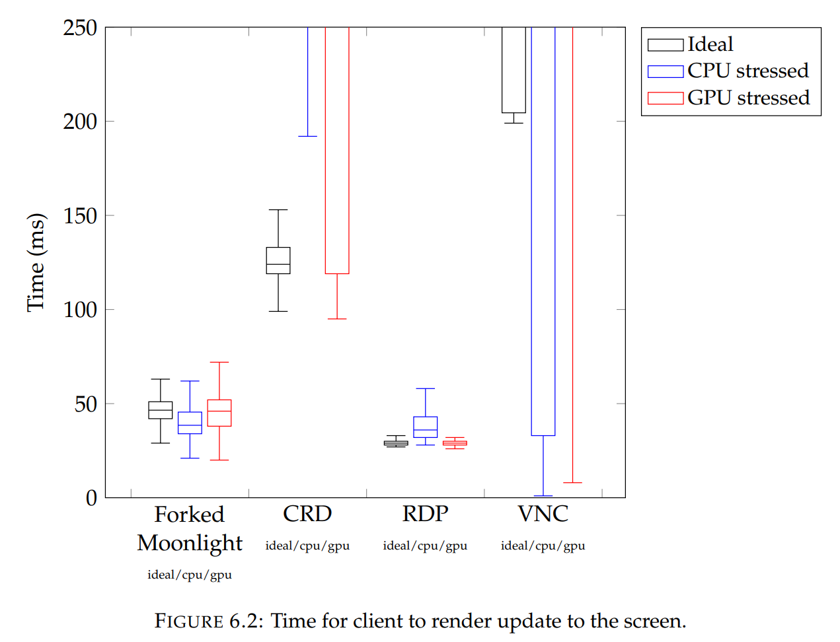
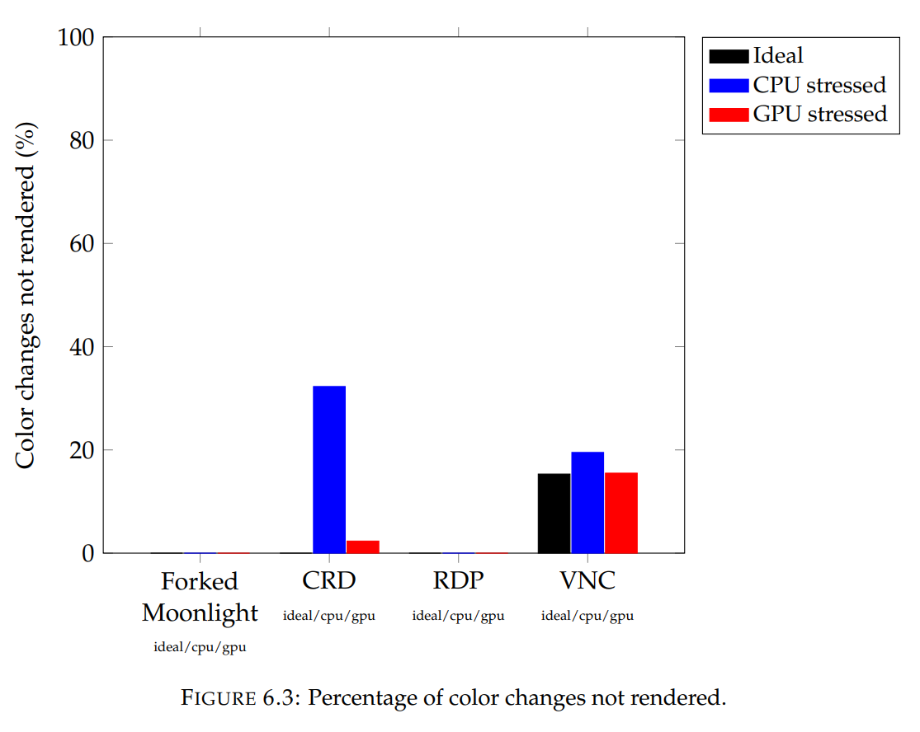
Responsivity and Latency

Slide 17
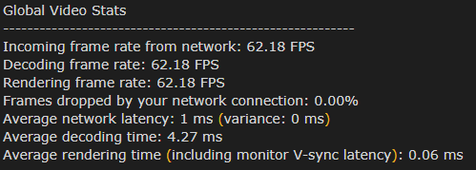
Evaluation
VNC failed to provide a smooth experience
CRD struggles when host under stress
RDP highly performant, but has drawbacks
Forked Moonlight provides high performance that isn’t limited by host’s load

Slide 18
Summary
Hardware
Is it feasible to construct a device capable of steaming a host’s screen at a lower or comparable cost to existing solutions?
Protocol
Does a protocol exist that is efficient enough to stream demanding applications to the client?
Software
Can a software solution be built to utilize this protocol in a
manner that performant enough?
Yes, for under $150
(potentially lower in bulk)
Yes, GameStream is useful for more than Video Games
Yes, built upon Moonlight, the stream is high-quality and highly performant

Slide 19
Limitations and the Future
Testing across networks
Chip shortages and problematic components
Improving user experience
Build an enclosure

Slide 20
Thank you!
Dylan Lathrum

